Slide 1
P552 Manufacturing analysis
Anamika Shelar

Slide 2
summary
Objective:The primary objective is to create a dynamic and insightful dashboard that helps corporate teams and branch heads monitor and enhance branch performance, ensuring alignment with overall business goals.
Tools : Excel, Tableau, Power-BI + MySQL
Benefits:
Enhanced Visibility: Provides clear insights into performance metrics at both branch and individual levels.
Data-Driven Decisions: Facilitates strategic decision-making based on accurate and up-to-date data.
Targeted Strategies: Helps identify areas for improvement and develop targeted strategies to boost business performance.
Improved Accountability: Encourages accountability by tracking individual contributions and achievements.

Slide 3

AGENDA
Manufactured Quantity
Rejected Quantity
Processed Quantity
Wastage Percentage
Employee Wise Rejected Quantity
Machine Wise Rejected Quantity
Production Comparison trend
Delivery period Analysis
Machine cost per operation
Top Buyers

Slide 4
KPI’s
Manufactured Qty 8,67,66,796
Processed Qty
8,62,42,067
Rejected Qty
5,24,729
Wastage % 0.61%

Slide 5
KPI’s
Processed Qty
8,62,42,067
Manufactured Qty 8,67,66,796
Rejected Qty
5,24,729
Wastage % 0.61%

Slide 6
KPI’s
Rejected Qty
5,24,729
Manufactured Qty 8,67,66,796
Processed Qty
8,62,42,067
Wastage % 0.61%

Slide 7
KPI’s
Wastage % 0.61%
Manufactured Qty 8,67,66,796
Processed Qty
8,62,42,067
Rejected Qty
5,24,729

Slide 8
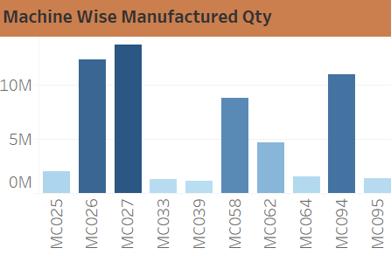
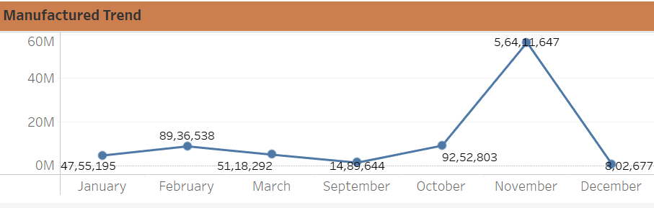
Machine MC027 registered the highest manufactured quantity, totalling over 10.2 M.
The average number of units manufactured by all machines is 5.7 M.
Machine MC102 manufactured the least number of units, totalling only 493 units.

Slide 9
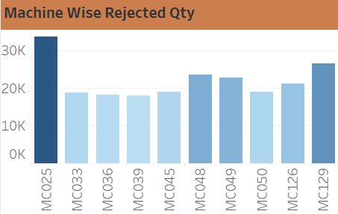
Machine MC025 registered a large number of rejections, totalling 33,660.
The average number of rejections made by all machines is 22,037.
Machine MC061 produced the least number of rejections, totalling only 10.

Slide 10
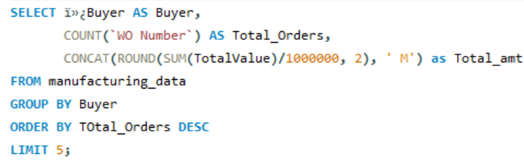

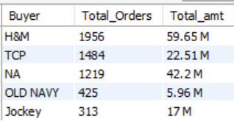
Top 5 buyers

Slide 11
Delivery Period
More number of orders got delivered early with 3419 orders i.e., 32.02%.
Orders which delivered Late and On time has almost equal proportion i.e., 24%
Least number of orders are under production with order count 2124 out of 10,679 orders(19.89%).
Total Orders 10,679

Slide 12
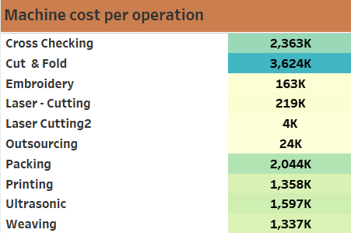

Machine Cost per operation

Slide 13

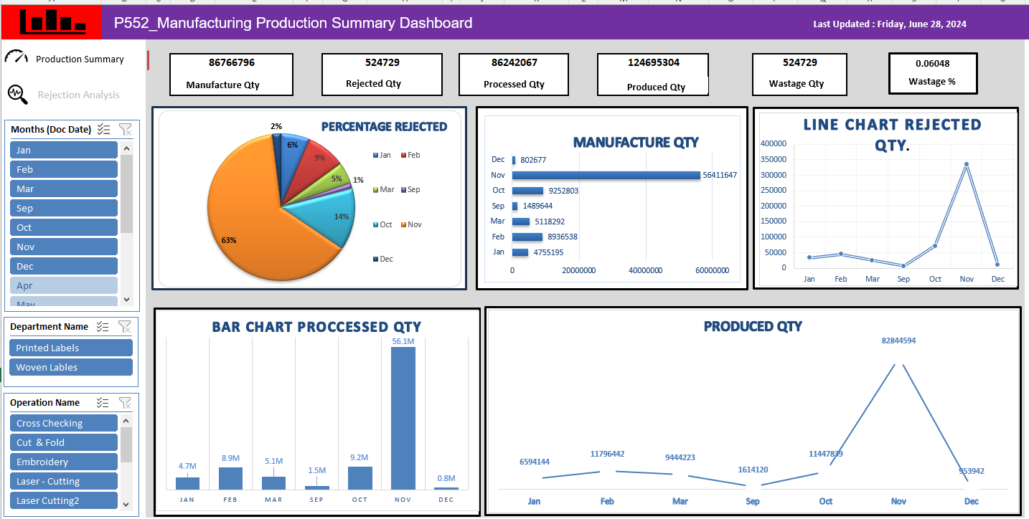
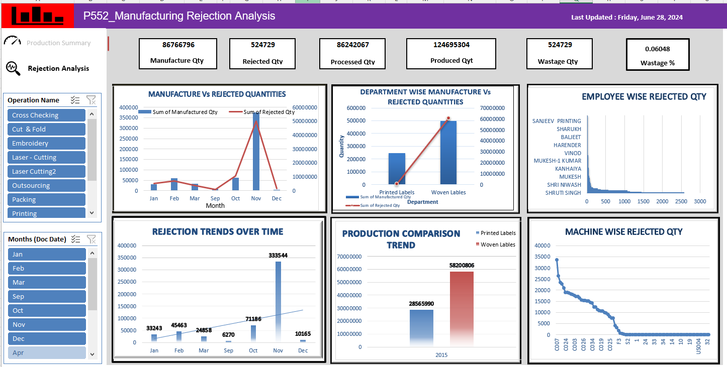
EXCEL DASHBOARD

Slide 14
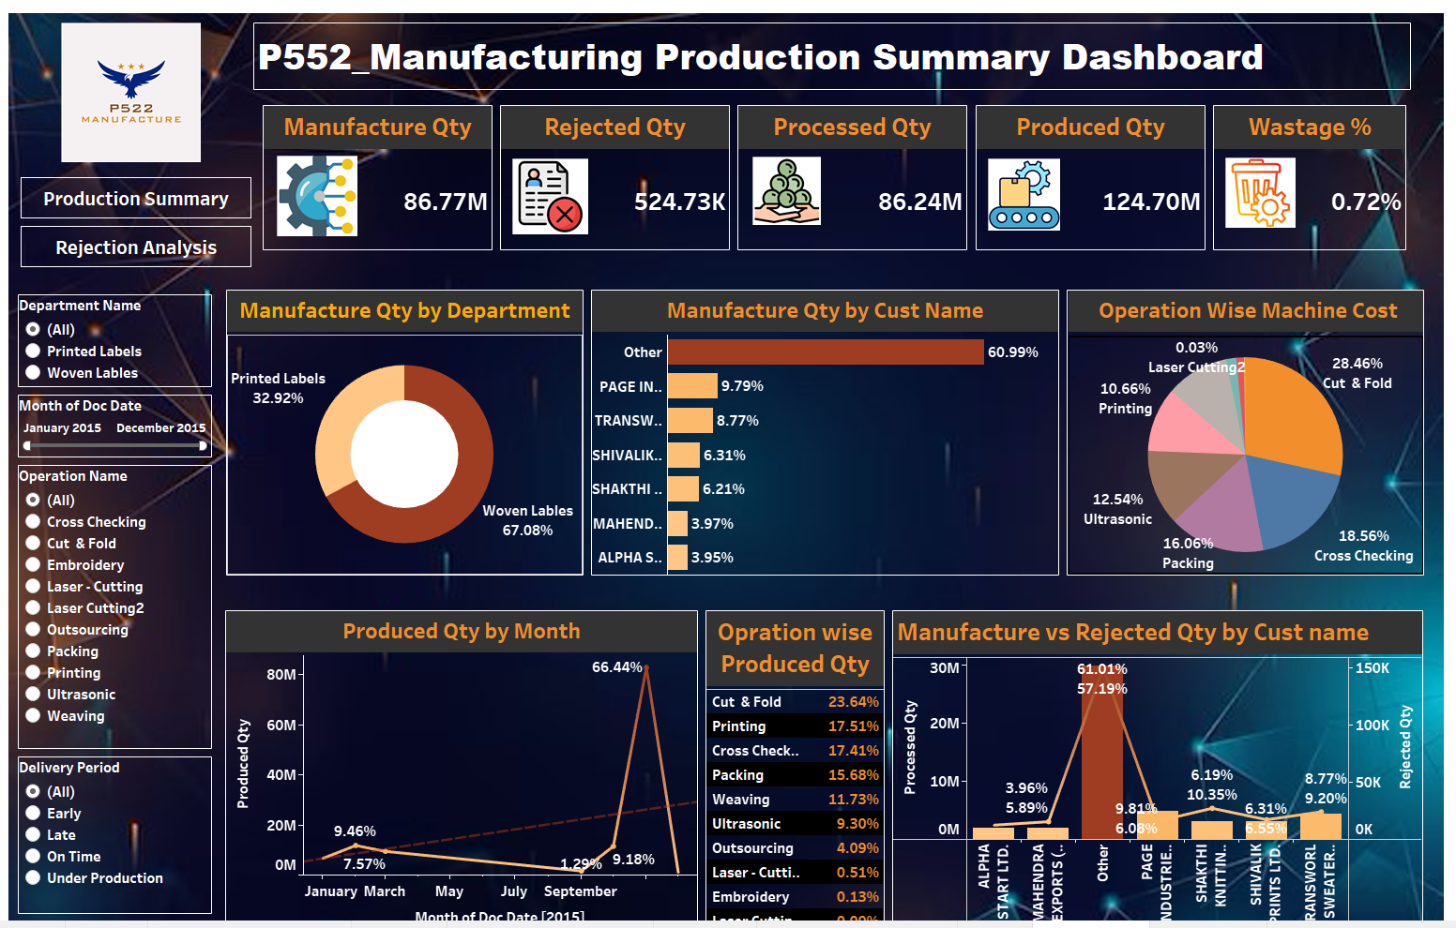
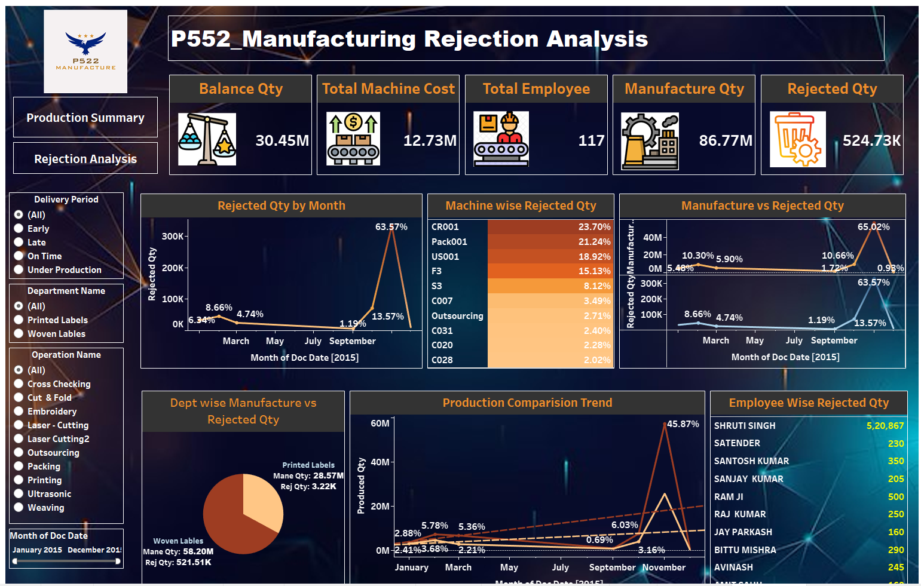
TABLEAU DASHBOARD

Slide 15

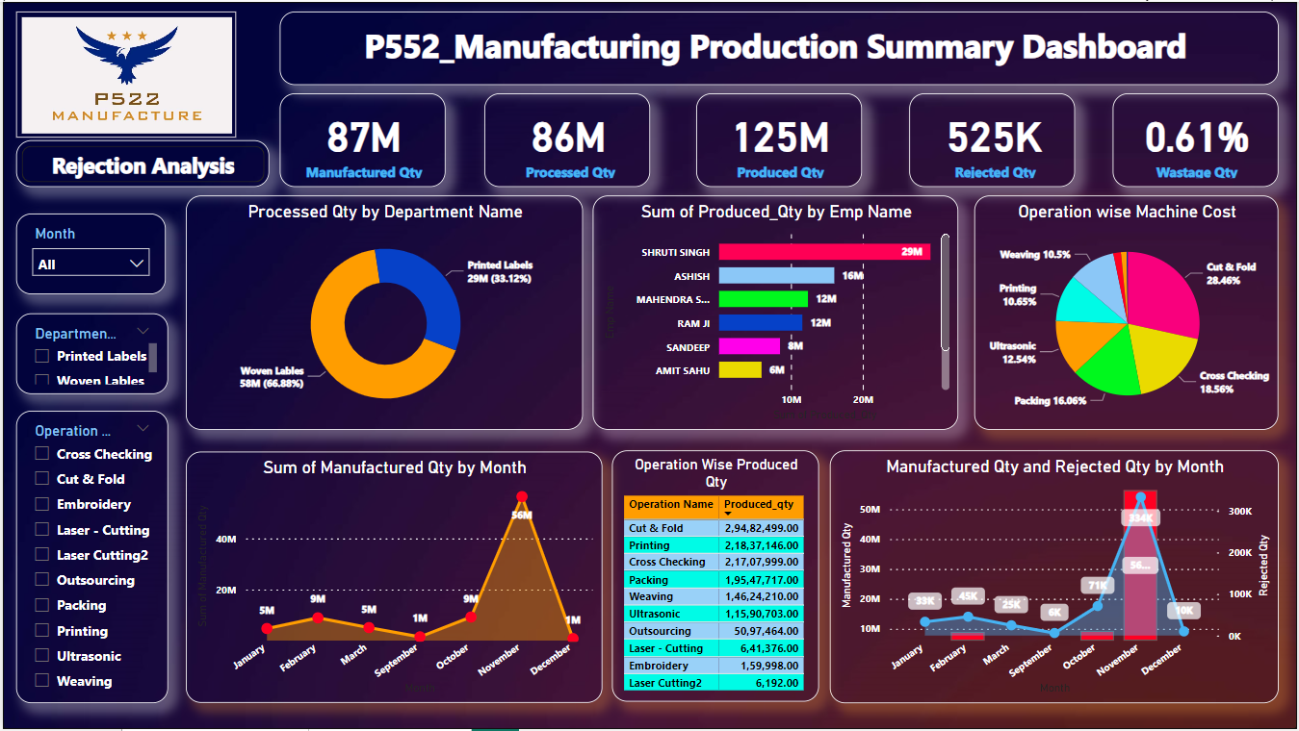
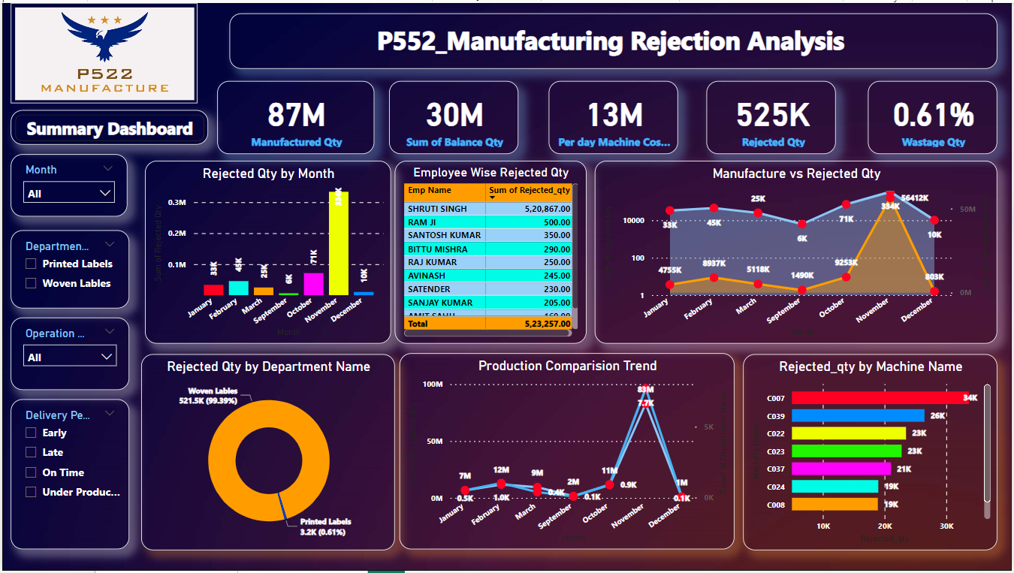
POWER BI DASHBOARD

Slide 16
Key Takeaways
In manufacturing
Highest percentage increase is 509.67% (Oct-Nov).
Highest percentage decrease is 98.57% (Nov-Dec)
In Rejection
Highest increase in rejection rate is 368.55% (Oct-Nov)
Highest decrease in rejection rate is 96.95% (Nov-Dec)
Continue quality improvement initiatives and address units with higher downtime to enhance efficiency.
Continue production in the months of Apr, May, Jun, July and August for enhanced profits.
Optimize shift schedules and focus on identified bottlenecks for smoother production flow.
Improve quality control, optimize costs, balance production schedules, and analyse customer-specific issues.
Recommendations
Conclusion
Overall Insights:
Quality control and efficiency improvements have positively impacted production metrics.
Specific areas for further optimization and focus have been identified.
Next Steps: Implement recommended actions to sustain and enhance production performance.

Slide 17
Thank you

